Slide 1
Module 6 Software Risk, Configuration management and Quality Assurance
6.1 Risk identification, Risk Assessment, Risk projection (estimation)
RMMM (Risk mitigation, monitoring, and management )
6.2 Software configuration management, SCM Repository, SCM Process
6.3 Software Quality Assurance Task and Plan, Metrics, Software Reliability, Formal Technical Review(FTR) and walkthrough

Slide 2
Software Reviews

Slide 3
Reviews
Software reviews are a “filter” for the software process.
The intent of every technical review is to find errors and uncover issues that would have a negative impact on the software to be deployed.
Software reviews “purify” software engineering work products including
Requirements
Design models
Code
Testing data
Industry data indicates that reviews provide a significant return on investment.
Classes of Reviews:
Informal
Formal

Slide 4
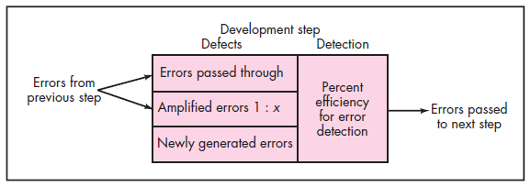
DEFECT AMPLIFICATION AND REMOVAL
Defect amplification model

Slide 5
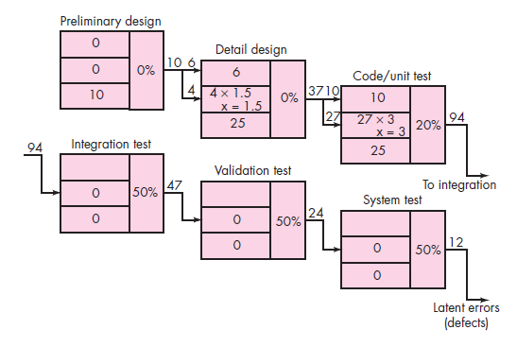
Defect amplification—no reviews

Slide 6
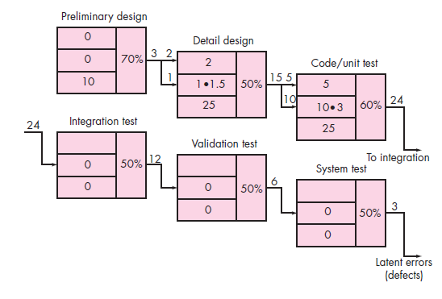
Defect amplification— reviews conducted
The total cost for development and maintenance when reviews are conducted is 783 cost units.
When no reviews are conducted, total cost is 2177 units—nearly three times more costly.
The number of errors uncovered during
each of the steps noted in both the figures is multiplied by the cost to remove an error
1.5 cost units for design
6.5 cost units before test
15 cost units during test
67 cost units after release

Slide 7
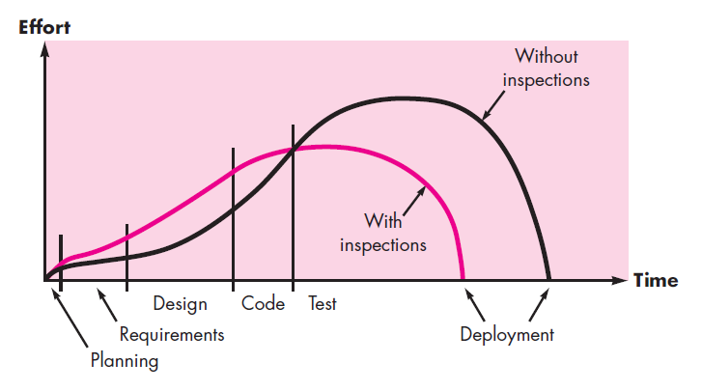
Effort expended with and without reviews

Slide 8
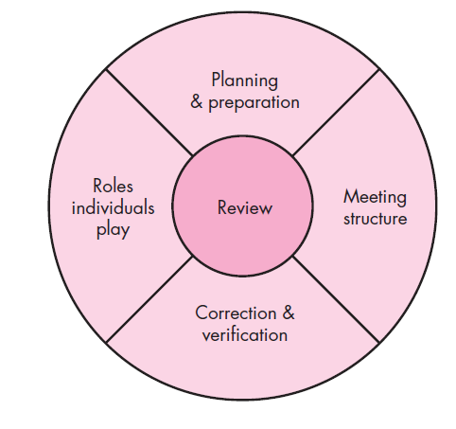
Reference model for technical reviews

Slide 9
Classes of Reviews: Informal and Formal
Informal Reviews:
An Informal/A Casual meetings – to discuss technical problem
Also called Peer- reviews(giving document to colleague)
Mostly one-one meetings
No advance planning
No agenda is required and not formally reported
No Follow-up on the errors that are uncovered

Slide 10
Formal Technical Reviews (FTR)
The FTR is actually a class of reviews that includes
Walkthroughs
Inspections
FTR is conducted as a meeting and will be successful only if it is properly planned, controlled, and attended.

Slide 11
Formal Technical Reviews (FTR)
The objectives of the FTR are:-
To uncover errors in function, logic or implementation for any representation of the software
To verify that the software under review meets its requirements
To ensure that the software has been represented according to predefined standards
To achieve software that is developed in a uniform manner
To make projects more manageable

Slide 12
Formal Technical Reviews (FTR)
Review Meeting
Constraints:-
Between three and five people should be involved in the review
Advance preparation should occur but should require no more than two hours of work for each person
The duration of the review meeting should be less than two hours

Slide 13
Formal Technical Reviews (FTR)
Review Meeting
Begins with introduction of agenda and brief introduction by producer
Producer proceeds to walk through the work product
Reviewers raise issue
Recorder notes each problem or error

Slide 14
Formal Technical Reviews (FTR)
Review Meeting
At the end, all attendees must decide whether to
Accept the product without further modifications
Reject the product due to severe errors
Accept the product provisionally

Slide 15
Formal Technical Reviews (FTR)
Review Reporting and Record Keeping
A review summary report answers three questions:-
Who has reviewed ?
Who reviewed it?
What were the findings and conclusions?

Slide 16
Formal Technical Reviews (FTR)
Review Guidelines
Review the product not the producer
Set an agenda and maintain it
Limit debate and rebuttal
Enunciate problem areas but don’t attempt to solve every problem noted
Take written notes
Limit no. of participants and insist upon advance preparation

Slide 17
Formal Technical Reviews (FTR)
Review Guidelines
7. Develop a checklist for each product that is likely to be reviewed
8. Allocate resources and schedule time for FTRs
9. Conduct meaningful training for all reviewers
10. Review your early reviews

Slide 18
University Questions
What is FTR in SQA? What are its objectives? Explain steps in FTR.
Explain and Compare FTR and Walkthroughs
Explain different metrics used for maintaining software quality.

Slide 19
Difference between FTR and Walkthrough
A walkthrough is ‘a static analysis technique in which a designer or programmer leads members of the development team and other interested parties through a software product, and the participants ask questions and make comments about possible errors, violation of development standards, and other problems’
A review is ‘a process or meeting during which a software product is presented to project personnel, managers, users, customers, user representatives, or other interested parties for comment or approval’

Slide 20
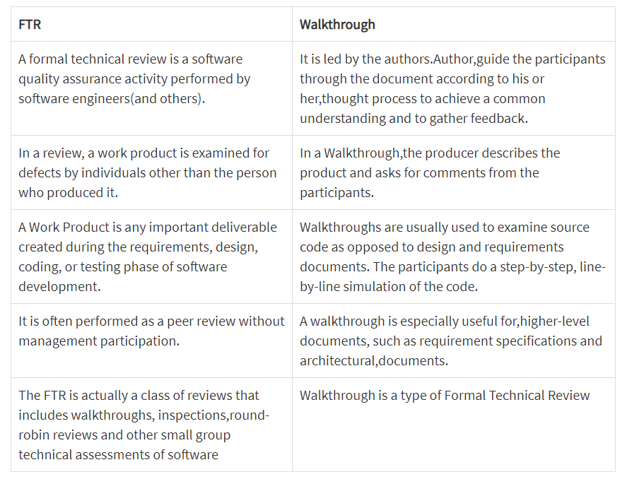
Contd…

Slide 21
Difference between Inspections and Walkthrough
Inspection | Walkthrough
Well formalized process | Comparatively less formal process than inspection
It uses checklist for locating errors | It does not uses checklist
It is used to analyze the quality of process | Used to improve quality of the product
It takes more time | Takes comparatively less time
It focuses on training of junior staff | It focuses on finding defects

Slide 22
Example for Checklist
Checklist for Interfaces:
• Is the layout designed using standard conventions? Left to right? Top to bottom?
• Does the presentation need to be scrolled?
• Are color and placement, typeface, and size used effectively?
• Are all navigation options or functions represented at the same level of abstraction?
• Are all navigation choices clearly labeled?

Slide 23
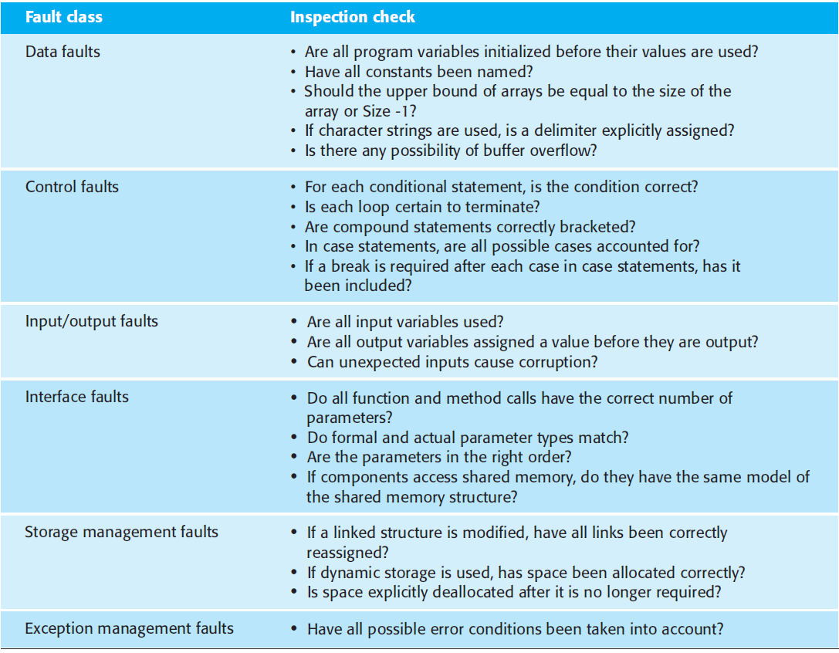
Contd… An inspection checklist

